Slide 1
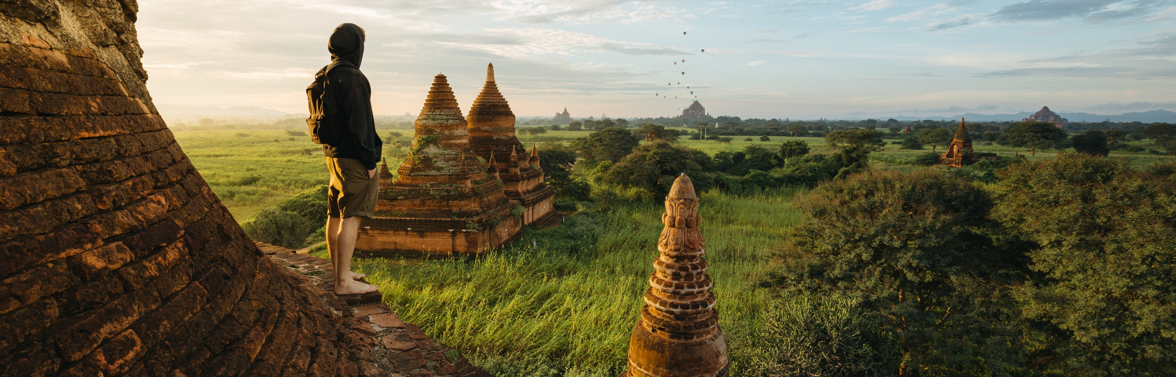
Tourism in VR
- Akhil Nair

Slide 2
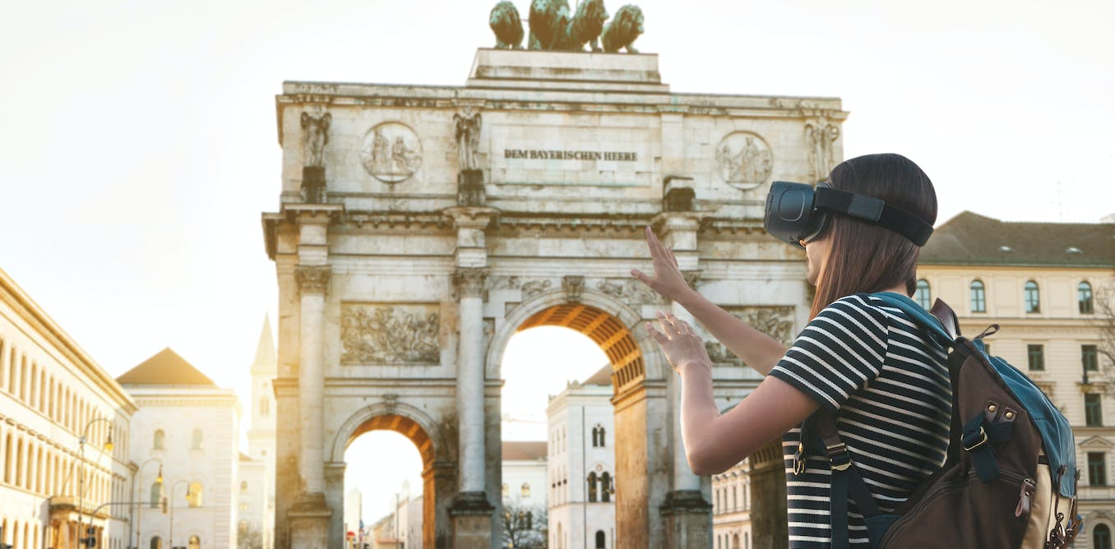
What is VR Tourism?
VR Tourism refers to creating lifelike travel scenarios
Users can explore distant regions, landmarks and attractions without evening stepping out
Often contain digital replicas of real structures that allow users to navigate and interact with them

Slide 3

Why VR Tourism?
Better accessibility for those that can’t visit in person
Learn of places difficult to get to, such as space or the deep sea
Explore places from the comfort of your home

Slide 4
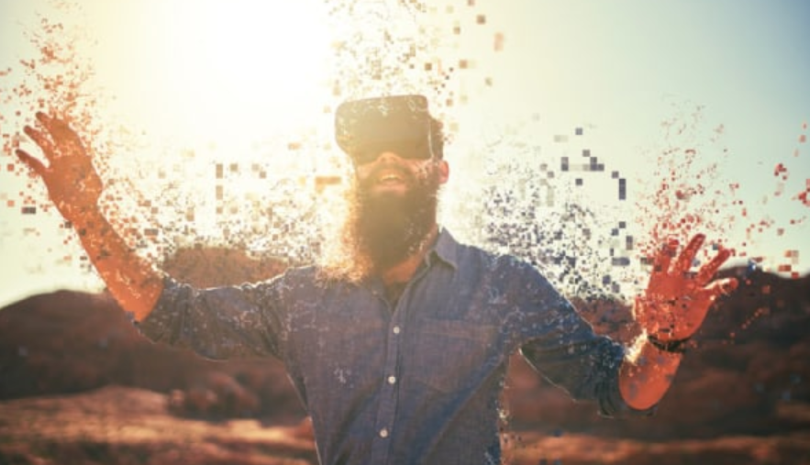
Current works in VR Tourism
Immersion VR: Is a UK based firm that specializes in 360-degree immersive VR
Matterport: Specialize in 3D Mapping technology for tourism and real estate
XplorIT VR: Create VR based content for travel and tourism purposes

Slide 5
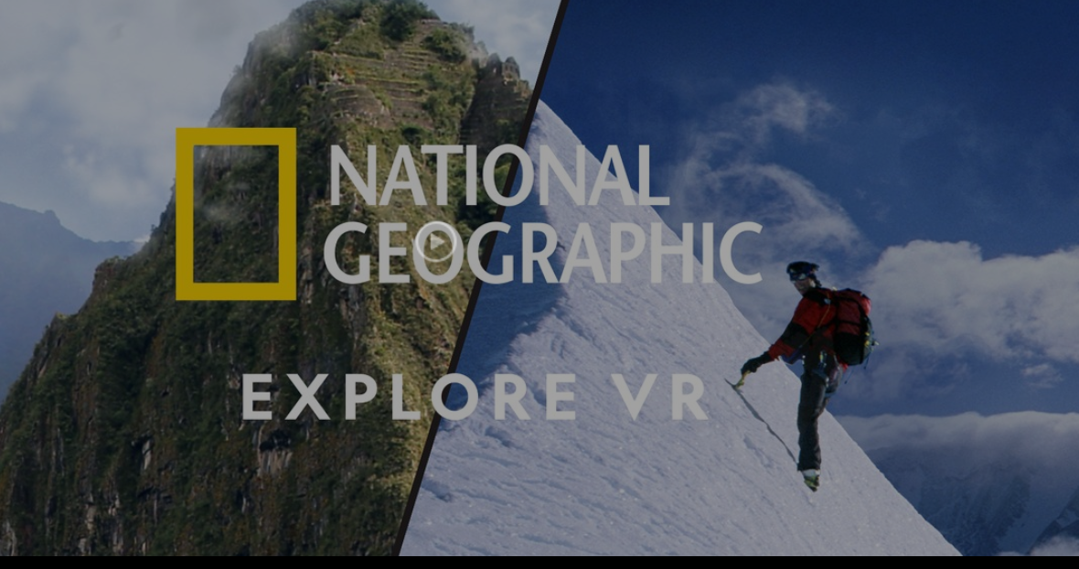
Project Inspiration
National Geographic VR: offers an immersive VR experience of various terrains
These terrains are not easily accessible due to their harsh environments and location
Experiences include kayaking in the Antarctic with whales, and exploring the Inca Citadel in Peru

Slide 6
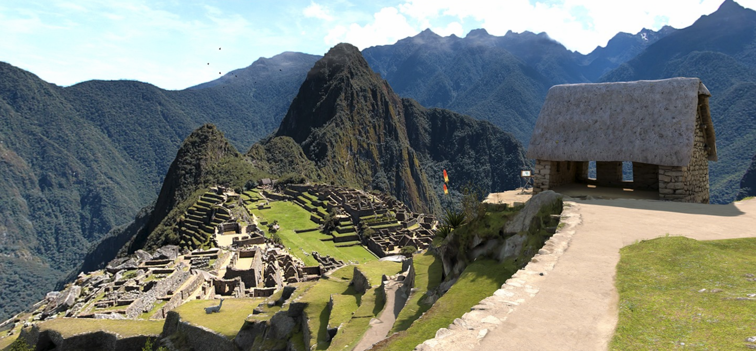
The Project
Involves exploring a vast mountain terrain that the user can freely move around in
Has activities that the user can engage in
Is a high-definition environment that seeks to offer a realistic tourism experience, much like Nat Geo

Slide 7
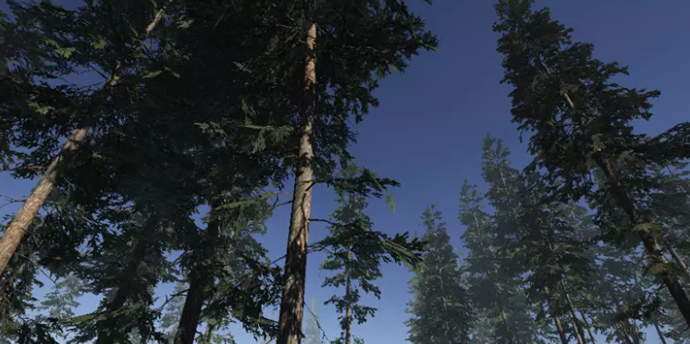
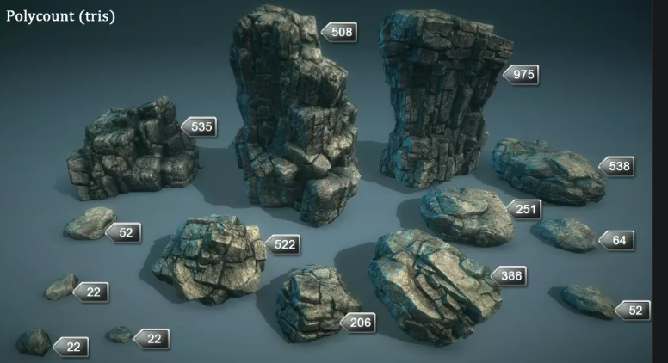
Assets used - 1
Coniferous trees pack – contains a wide variety of trees for mountainous areas
Rock and Boulder HD pack – has various types of rocks with colliders and high detail
Pistol pack – used to build guns that can be used at the shooting range

Slide 8
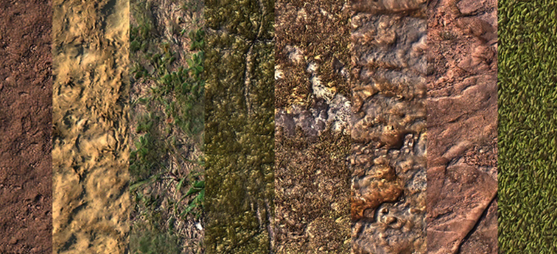

Assets used - 2
Outdoor Ground Textures – Various kinds of High-definition ground textures
HDR sky– Consists of 360-degree skyboxes that show the horizon and sky
Winter mountains and Stamps: Contain models of hills and mountains in HD

Slide 9
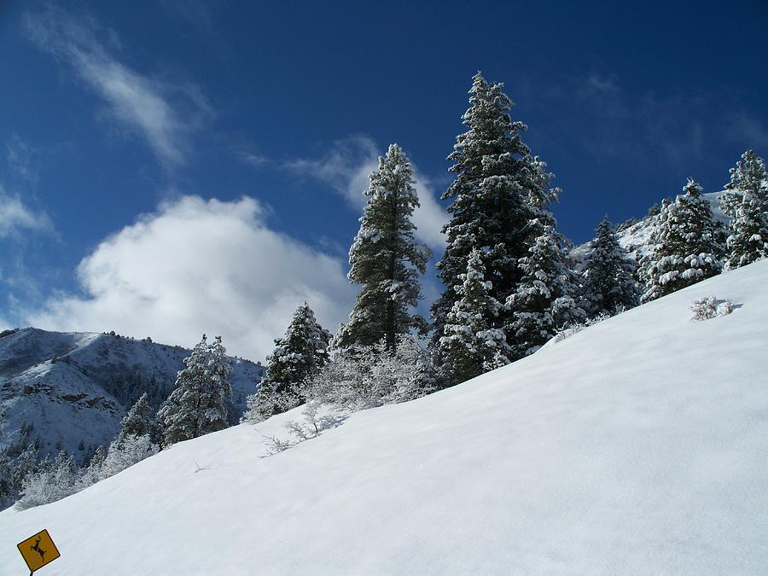
Terrain - 1
The first part of terrain consists of a giant snow slope for skiing downhill at steep incline
Created by modifying terrain with Unity’s sculpting features
User must avoid obstacles – trees and rocks in their way or face collisions

Slide 10
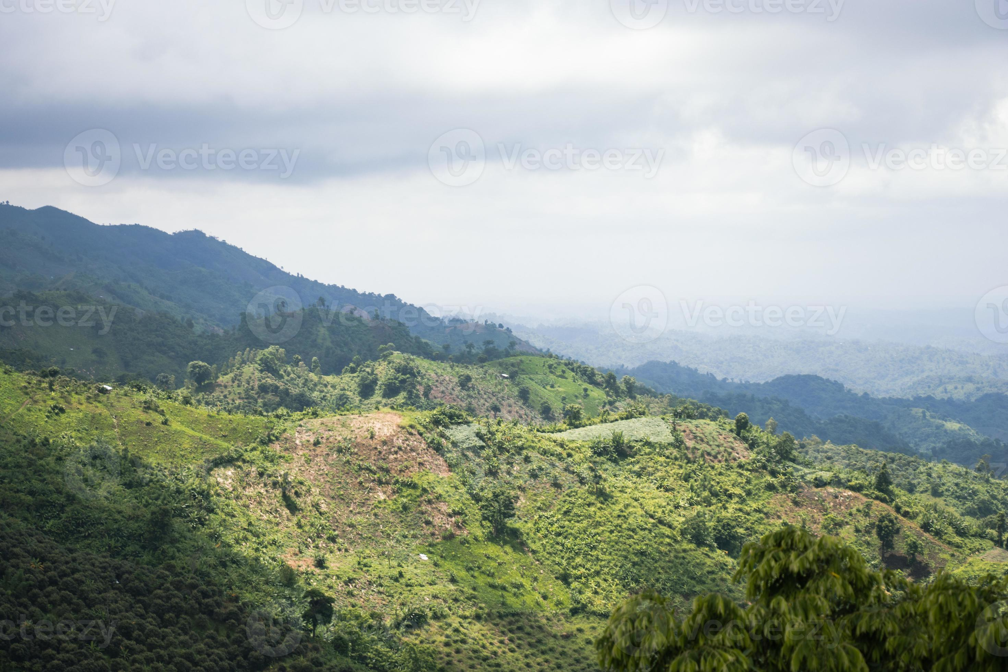
Terrain - 2
The next part of the terrain is mountain terrain, with various kinds of ground and mountain textures
Created with assets listed before + sculpting
Contain animated trees and grass that sway in the wind for a realistic experience

Slide 11
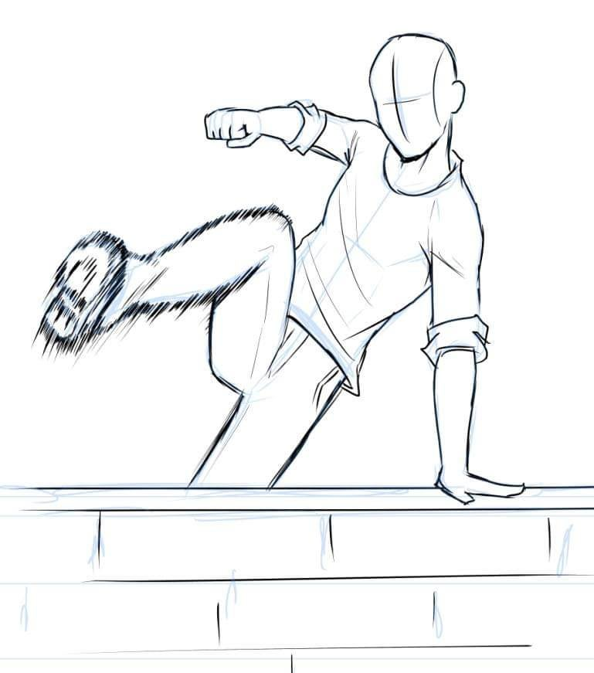
Movement and Interaction
The user moves using the XR interactive toolkit for Unity
This allows for looking around, continuous movement in any direction, and make snap turns
This toolkit also allows to grab and interact with objects in the virtual world

Slide 12
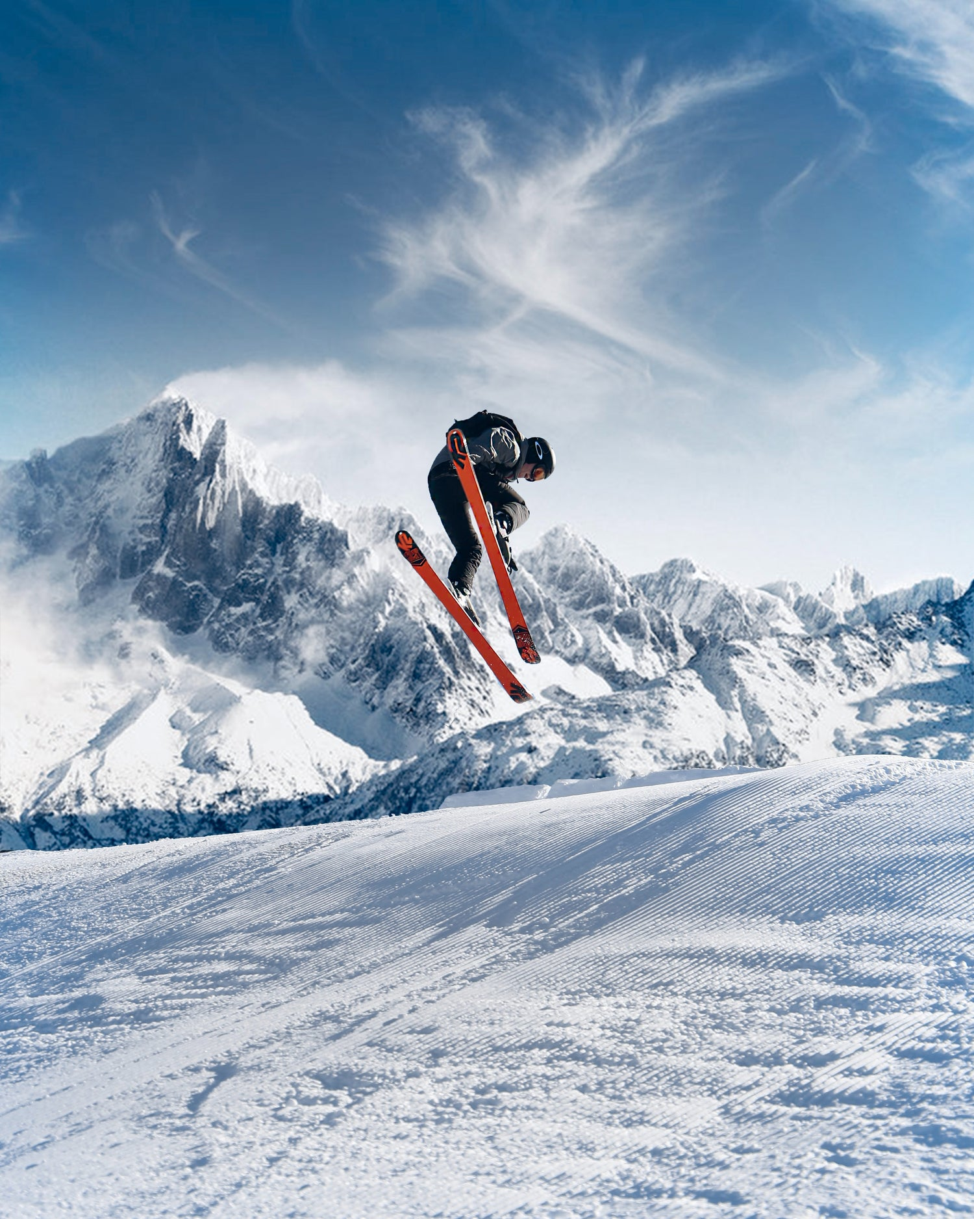
User engagement in project
Activities include skiing and a shooting range
Skiing: The user grabs ski poles and skis downhill, avoiding obstacles
Shooting range: Has interactable guns in the forest that shoot targets that are destroyed upon impact

Slide 13

Challenges faced
Original idea of a Volcano tour was changed due to a lack of assets
Scaling the hill for skiing was a challenge due to the size of the mountains, time consuming
The user now starts atop the largest mountain and eventually goes lower into the forest

Slide 14
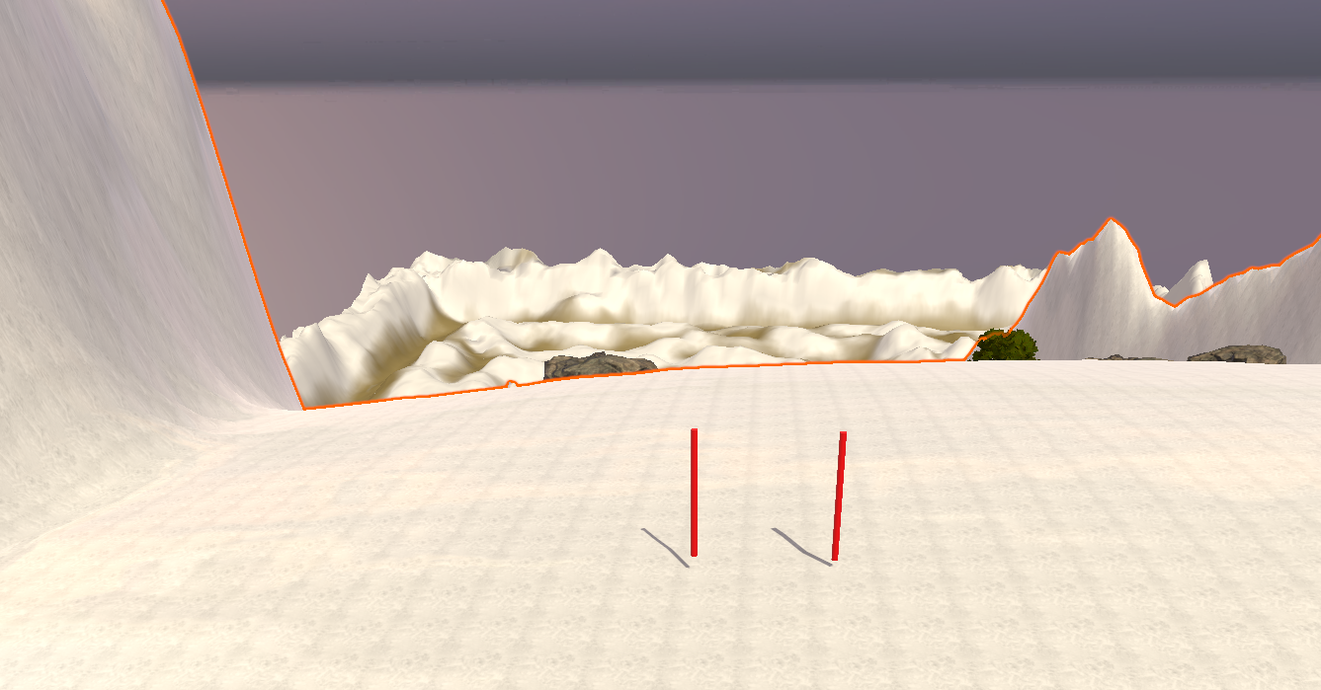
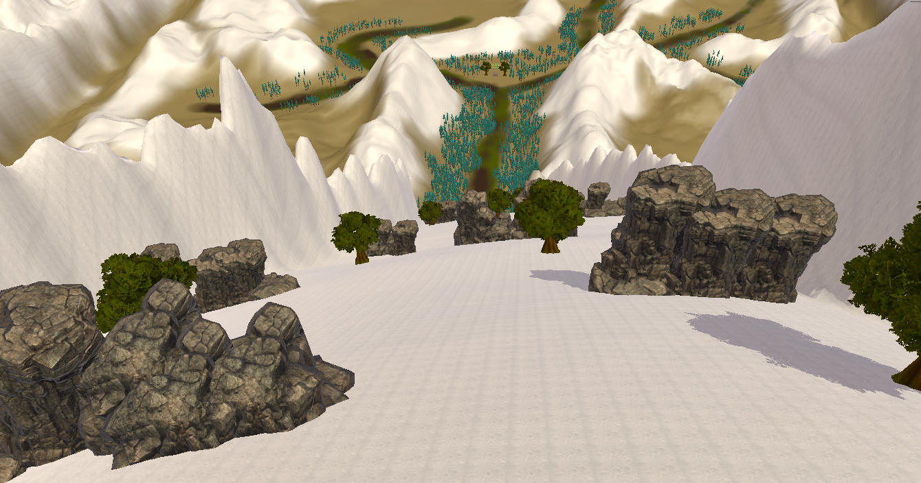
Project Screenshots - 1
Start point, grab ski poles and begin
Avoid obstacles and go skiing!

Slide 15
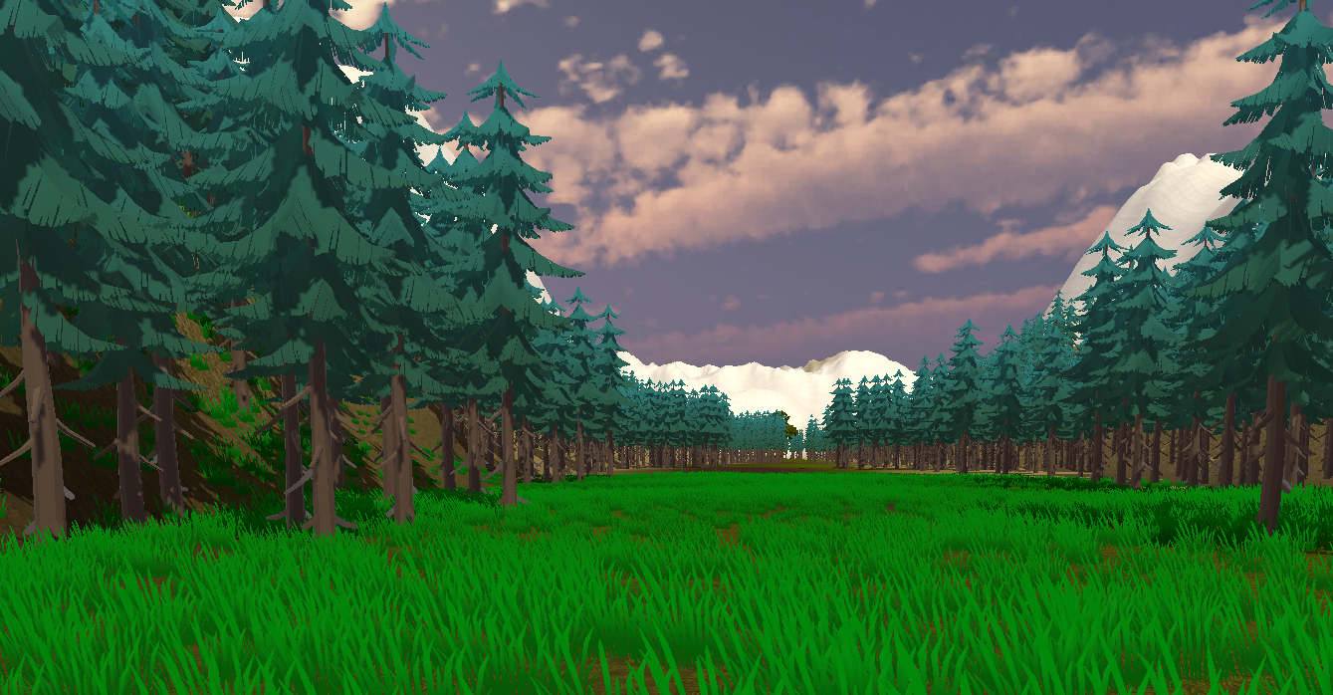
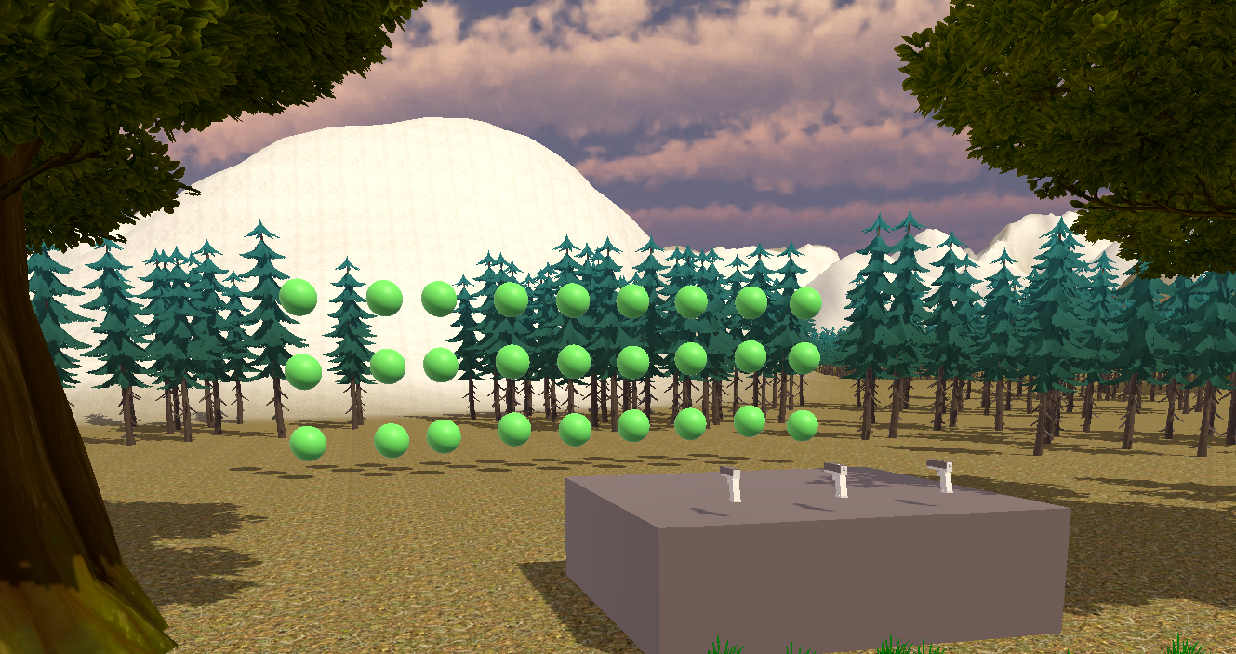
Project Screenshots - 2
The forest terrain
Shooting range with interactable guns

Slide 16
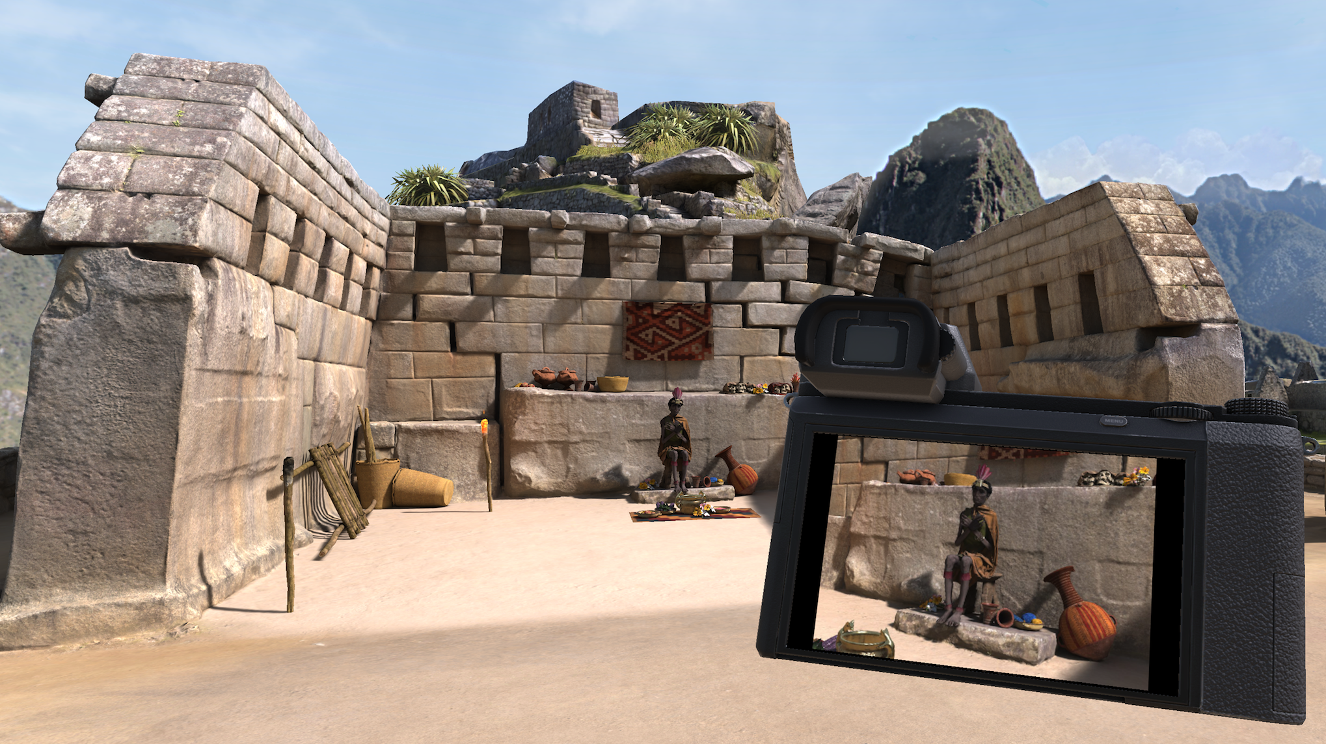
Project applications
More realistic versions can be used for open world gaming and entertainment
Cultural heritage can be preserved by creating endangered sites in VR
Could be used for real estate, allowing buyers to check homes virtually before deciding

Slide 17
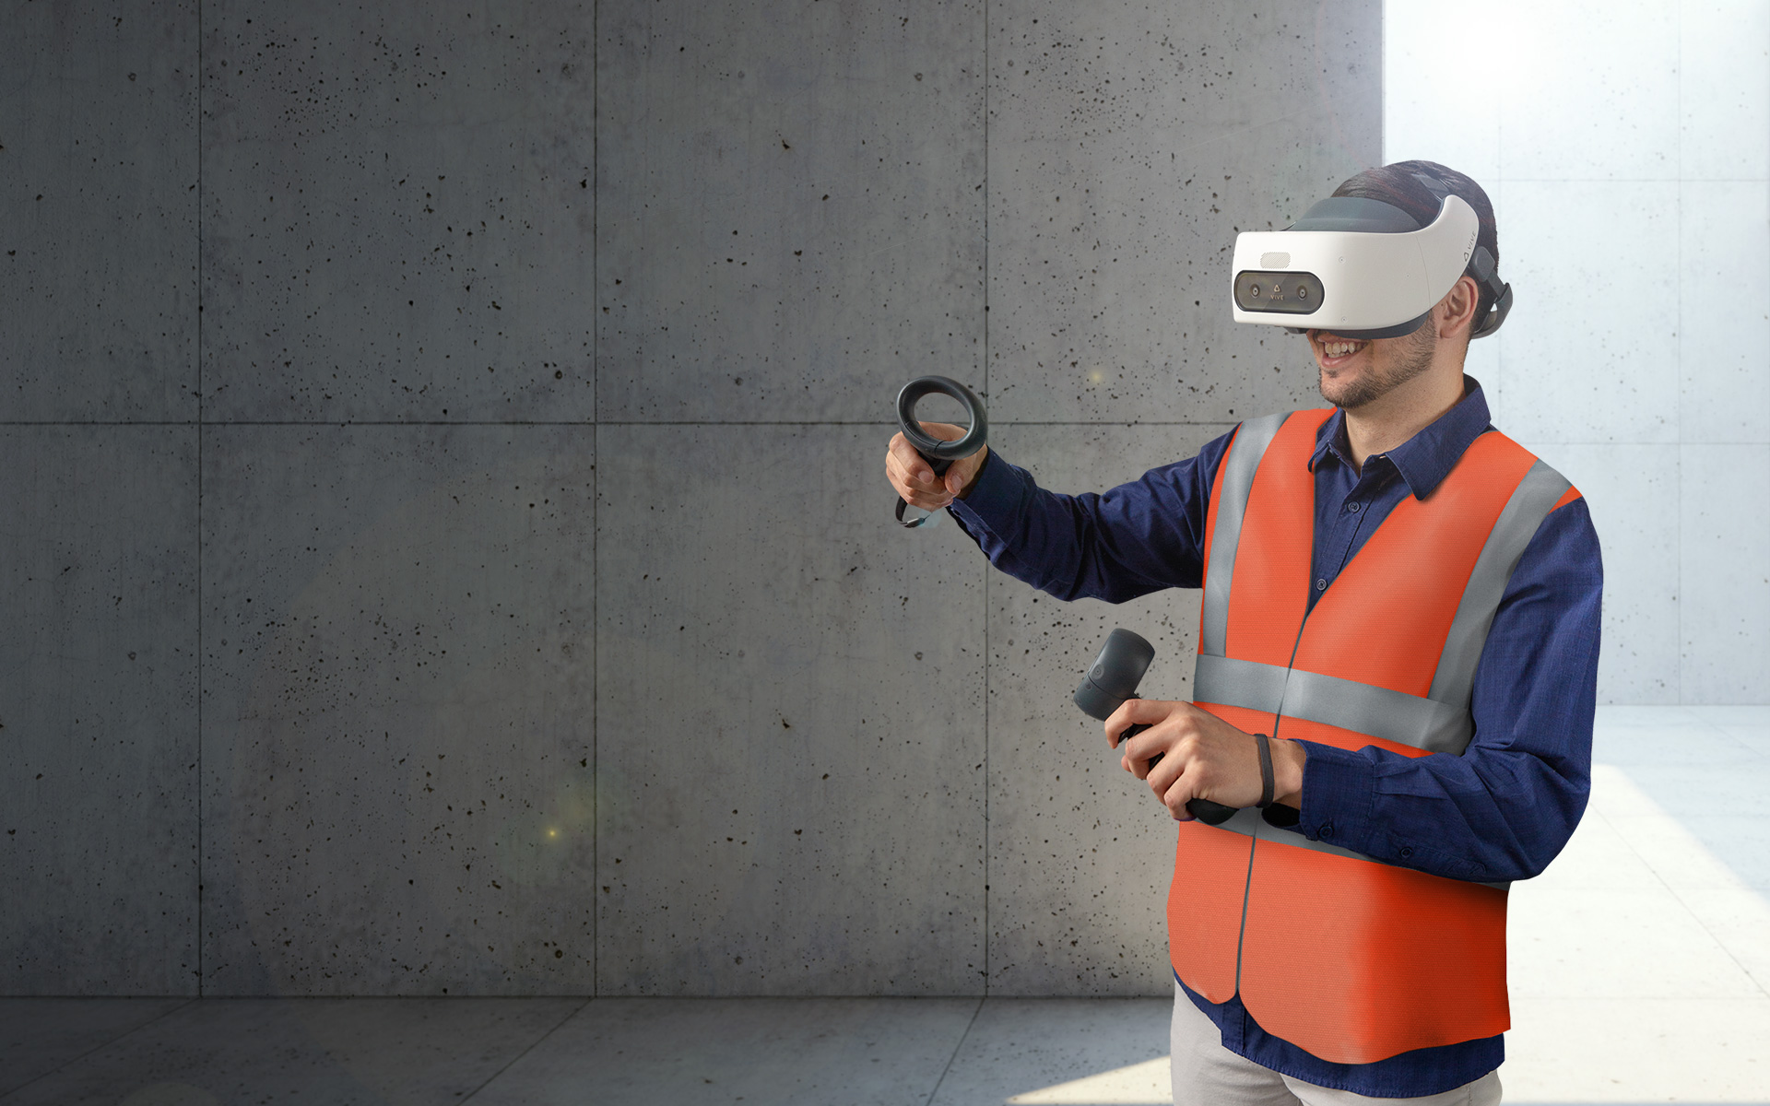
User safety in VR Tourism
Immersive VR environments should not cause motion sickness or disorientation
The surrounding areas must be clear of obstacles to minimize the risk of injury
The user must be given instructions on how to navigate the virtual world

Slide 18
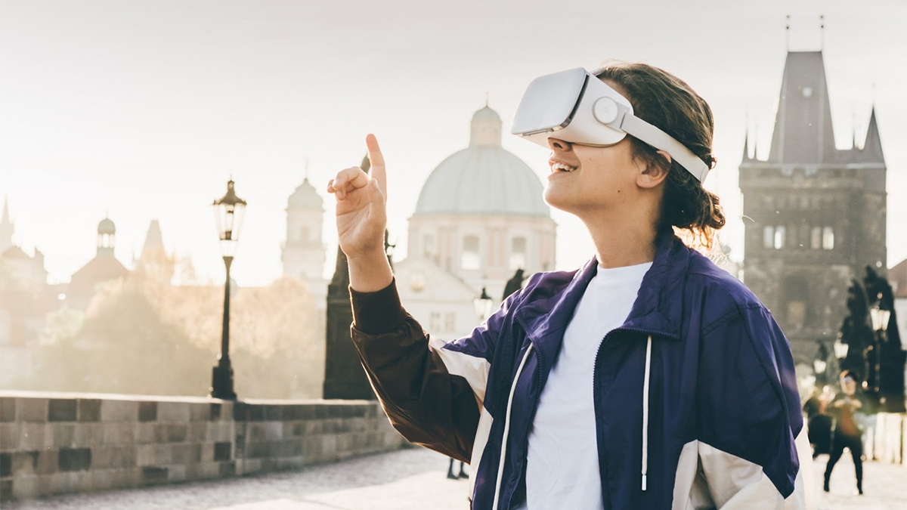
Future scope of VR Tourism -1
Collaborative travel: VR platforms may let users travel to virtual destinations together
Integration with AR can allow for a better understanding of surroundings
Could be used for education, teaching students history and geography and biomes

Slide 19
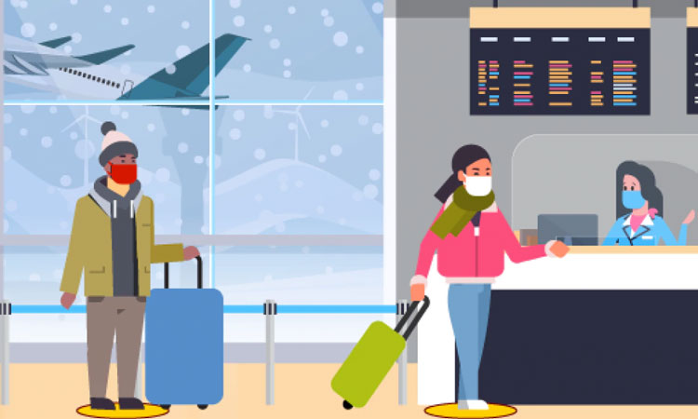
Future scope of VR Tourism -2
Better applications for space travel may let people experience the cosmos
Travel recommendations can be made based off the user’s likes and dislikes in VR
Technological progress will lead to even more realistic environments that mimic real life

Slide 20
Conclusion
An immersive, interactable open world, VR environment has been developed
It gives the user free reign to move about and explore various aspects of nature
Lays the foundations for more complex and intricate works to follow

Slide 21
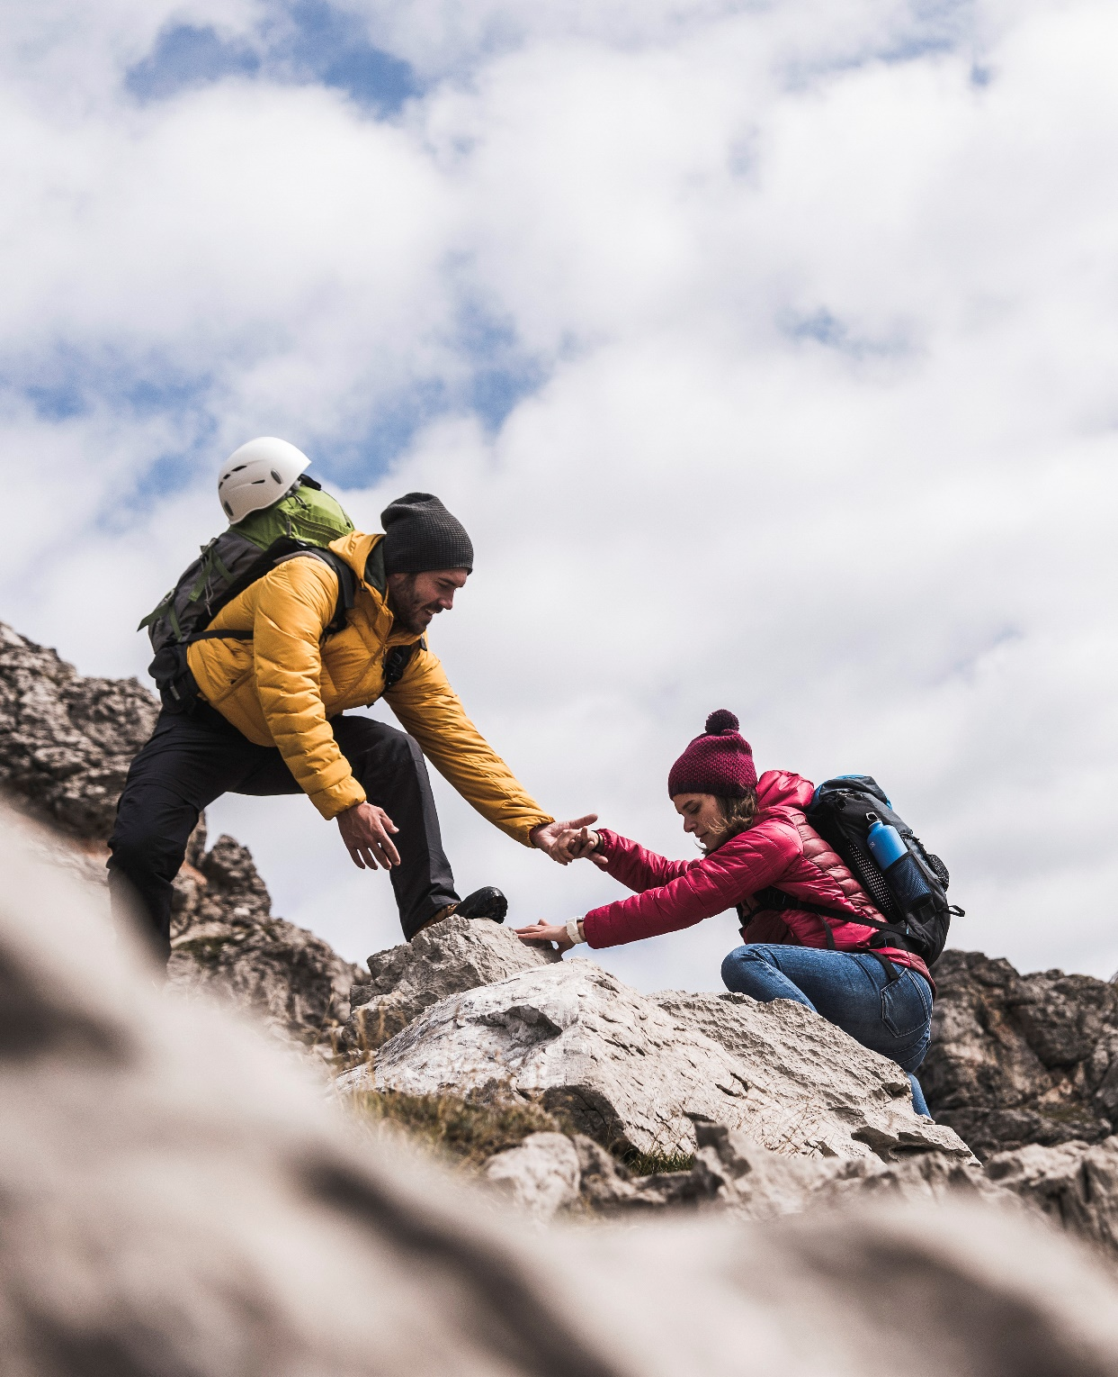
Thank You!

